Slide 1

GemMail: AI-Powered Email Generation
GemMail streamlines email writing using Gemini API's natural language processing. It creates contextually appropriate responses with customizable tone.
Our Chrome extension integrates directly with Gmail for seamless workflow enhancement.

Slide 2





Project Goals
Web Application
Develop a working app that creates AI-generated email responses.
Gemini API
Utilize advanced NLP for text generation.
Tone Control
Give users control over response tone.
Browser Extension
Create seamless Gmail integration.

Slide 3





System Architecture
Frontend (React)
User interface built with React and Material UI.
Backend (Spring Boot)
Handles API requests and orchestrates email generation.
Gemini API
Powers email content generation based on input and tone.
Browser Extension
Integrates functionality into Gmail UI.

Slide 4
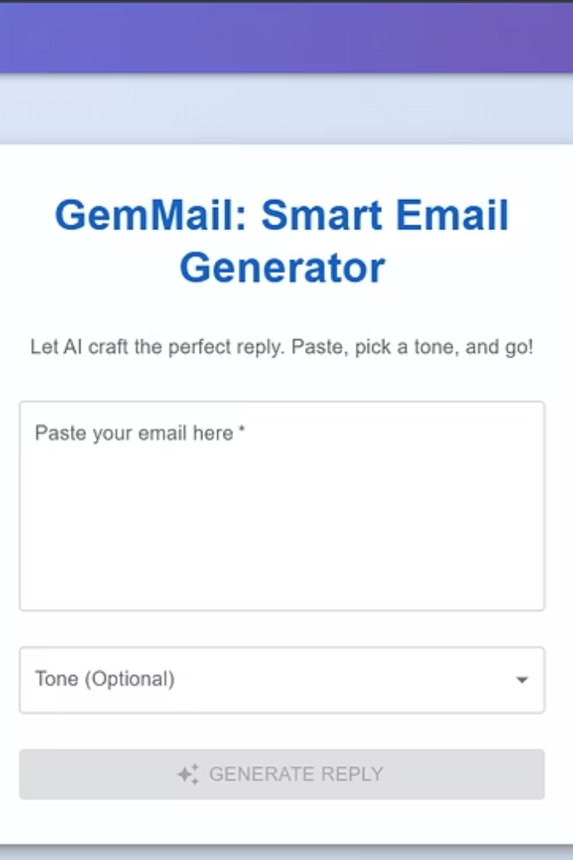
Frontend Features
Material UI Components
Email Input & Tone Selection
Modern, responsive interface with pre-designed components for consistent user experience.
Text field for email content and dropdown for selecting response tone.
Generate & Copy Buttons
One-click generation and clipboard copying for seamless workflow integration.

Slide 5








Backend & API Integration
API Endpoints
RESTful endpoints for email generation requests
Gemini API Integration
Manages interaction with NLP services
Tone Management
Translates user tone selection into prompts
Error Handling
Robust processes for catching exceptions

Slide 6

Browser Extension
Gmail Integration
Adds "Generate with GemMail" button directly in Gmail's compose window.
Context Extraction
Uses JavaScript to extract email content from current Gmail thread.
API Communication
Sends extracted content to backend for processing.
Response Insertion
Places generated response in Gmail compose window.

Slide 7





Development Process
Planning & Design
Defined goals, created architecture diagrams, and designed UI mockups.
Frontend Development
Built React interface with Material UI components.
Backend Development
Created Spring Boot API and Gemini integration.
Extension Development
Built JavaScript extension for Gmail integration.
Testing & Deployment
Performed testing and deployed to hosting platform.

Slide 8
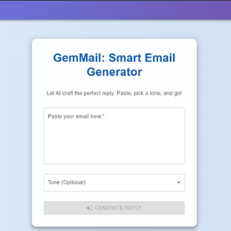
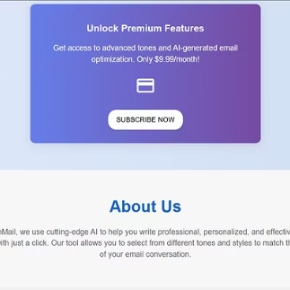
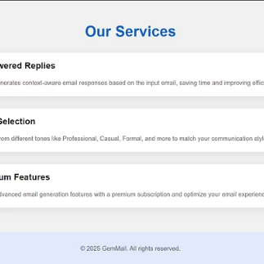
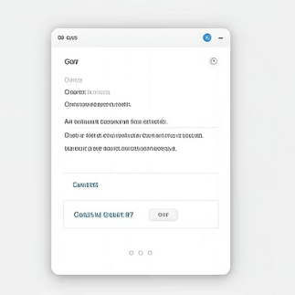
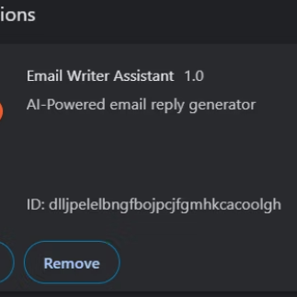
Application Screenshots
GemMail's intuitive interface makes email composition effortless. The extension seamlessly integrates with Gmail.

Slide 9
Challenges & Results
Key Challenges
Successful Results
Gemini API integration
Functional web application
Gmail's dynamic environment
Seamless Gmail integration
Tone personalization
Positive user feedback
Asynchronous operations
Strong foundation for expansion
Cross-browser compatibility

Slide 10










Future Scope
Multilingual Support
Platform Expansion
Email responses in different languages.
Support for Outlook and Yahoo Mail.
Personalization
Training on user-specific data.
Premium Features
Paid version with advanced capabilities.
Mobile Application
Email support on the go.

Slide 11
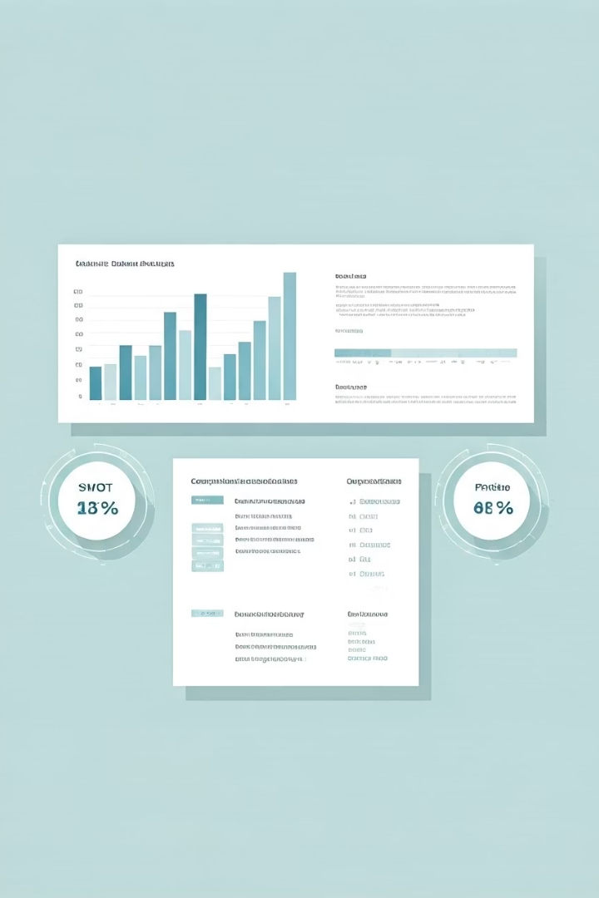




Competitor Analysis
We carefully studied the landscape of AI email assistants to position GemMail for success.
Gmail Smart Compose
Offers in-line suggestions but lacks full email generation and tone control.
AI Writing Assistants
Grammarly and Jasper provide content help but aren't email-specific or context-aware.
Email Templates
Static solutions miss personalization that GemMail delivers through AI.
GemMail Advantage
Our Gmail integration and tone customization create unique value in the market.

Slide 12


Key Features
Tone Customization
Gmail Integration
One-Click Copy
Adjust email tone from casual to formal with simple slider controls. Perfect for matching company culture or recipient preferences.
Browser extension works directly within Gmail. Analyze recipient history for context-aware email generation.
Generate and transfer content to email draft instantly. No switching between applications required.

Slide 13




User Personas: Who GemMail Serves
Business Professionals
Customer Support Teams
Executives and managers who need quick, professional responses. Save hours on routine correspondence.
Agents handling high email volumes. Create consistent, helpful replies at scale.
Sales Representatives
Students & Academics
Salespeople engaging prospects and clients. Craft persuasive follow-ups that convert.
Learners needing formal communication with professors. Generate well-structured emails effortlessly.

Slide 14
Real User Journey
GemMail simplifies email communication through an intuitive workflow that integrates directly with Gmail.
Open an Email
User selects an email thread in Gmail. GemMail extension activates automatically in the sidebar.
Select Response Type
Choose whether to compose a new email or respond to existing conversation.
Adjust Tone Settings
Set preferred communication style using intuitive sliders from casual to formal.
Generate Content
AI analyzes email context and creates personalized response based on settings.
One-Click Transfer
Generated content appears instantly in Gmail compose window with a single click.

Slide 15





What's Coming Next for GemMail
Q2 2025: Multilingual Support
Email responses in 15+ languages with cultural context awareness.
Q3 2025: Outlook Integration
Expanding our platform beyond Gmail to reach more users.
Q1 2025: Mobile Application
Native iOS and Android apps for email assistance on the go.
Q2 2025: Team Collaboration
Shared templates and tone settings for consistent team communication.
Q3 2025: Advanced AI Personalization
Learning from user habits to provide increasingly tailored responses.

Slide 16




Transforming Email Communication
GemMail redefines how we interact through email, saving time while maintaining authenticity.
Time Savings
Cut email writing time by 75%.
Personalization
Context-aware responses that maintain your voice.
Expanding Reach
Growing from Gmail to multichannel support.
Join us in creating more meaningful connections through better communication technology.

Slide 17

Thank You for Exploring GemMail
We're revolutionizing email communication through AI-powered assistance that preserves your authentic voice while saving valuable time.
Ready to transform your daily correspondence? Join our early access program today.

